Slide 1

Six Elements of a Marketing Plan
Executive Summary
Situation Analysis
Your SWOT
Elements of a Marketing Plan
Single goal of what to do as a company (based on swot)
Objectives
Marketing Strategies
Implementation
Evaluation and Control

Slide 2
Six Elements of a Marketing Plan
Executive Summary
Written last – defines the entire plans key points
Situation Analysis
Your SWOT
Elements of a Marketing Plan
Single goal of what going to do as a company.
Objectives
Marketing Strategies
4ps: Product, Place, Price, Promotion
Implementation
When, how, and who will implement plan, budget
Evaluation and Control
Measurement on how you are doing

Slide 3
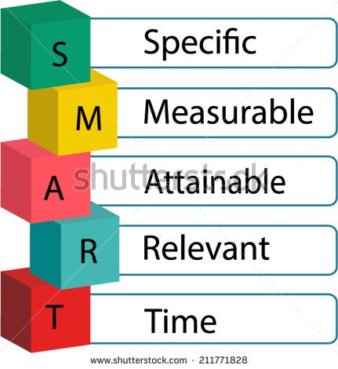
Increasing Sales using a SMART Goal?
Specific - Single focus
Measurable – something you must earn to succeed – a number, percentage, something tangible
Achievable – What things you do to earn it
Realistic – why it matters/the purpose
Timely - By what date/time frame

Slide 4
You conduct a SWOT of a business you learned a weakness you have is your sales are declining. While you carry a lot of different items, you notice your sweatshirt sales in the store are low. You decide to create a marketing plan around increasing your sweatshirt sales.
Let’s make this into a Smart Goal

Slide 5
“Use your notes to help you
Write a SMART Goal for “Sales are declining on sweatshirts”
S:
M:
A:
R:
T:

Slide 6
Use a SMART Goal? weakness sales are declining on sweatshirts
Increase the sale of Sweatshirts
By 10%
By increasing product options, marketing on social media, and having sales events
Increased Sales will increase my profit and allow us to buy new products
By August 1, 2026

Slide 7
SMART Goal = Increase sales on Sweatshirts by 10% by August 2026
Increase the sale of Sweatshirts
By 10%
By increasing product options, marketing on social media, and having sales events
Increased Sales will increase my profit and allow us to buy new products
By August 01, 2026

Slide 8
SMART Relay
Directions:
Your table will get a broad “Starter goal”
On your “Make This Goal Smart” handout Develop a SMART Goal from your broad “Starter Goal”
One student bring it to the teacher.
Teacher will read it, if incorrect you will be sent “Back to fix it”

Slide 9
“Make This Goal SMART”
Round 1
What is your Starter Goal:
S:
M:
A:
R:
T:
Round 2
What is your Starter Goal:
S:
M:
A:
R:
T:

Slide 10
Round 1 Relay:
Round 1: Starter goals:
Table 1: “Get better grades”
Table 2: “Graduate From High School”
Table 3: “Save more money”
Table 4: “Be more organized”
Table 5: “Become more social”

Slide 11
Round 2 Relay:
Round 1: Starter goals:
Table 1: “Graduate from High School”
Table 2: “Save more money”
Table 3: “Be more organized”
Table 4: “Become more social”
Table 5: “Get better grades”

Slide 12
In your Activity Packet: Assignment Write SMART Goals You want to get fit and be healthy. Write a specific, measurable goal to do that. Mrs. Vetter will check your notes on Monday.
S
M
A
R
T

Slide 13
Writing a Marketing Plan
marketing plan X A formal written document communicating the goals, objectives, and strategies of a company’s activities for a specific time
- written after conducting a SWOT Analysis
Purpose: A Roadmap of how a product will enter the market, be advertised and sold
It communicates to management:
Company goals, objectives and strategies
Specific responsibilities
Budgets
Deadlines for completion
Overall performance

Slide 14
Goal: Your have $4800 credit card debt that needs to be paid off.
Specific: I will pay off $4,800 on my credit card
Measurable: by paying $200 each month
Achievable: cut back unnecessary purchases, lower my monthly discretionary spending, don’t purchase items if I don’t have the money. Leave card at home
Relevant/Realistic: Will pay this off in 24 months, still have some fun money, and still save.
Timely: By November 2021.

